Slide 1
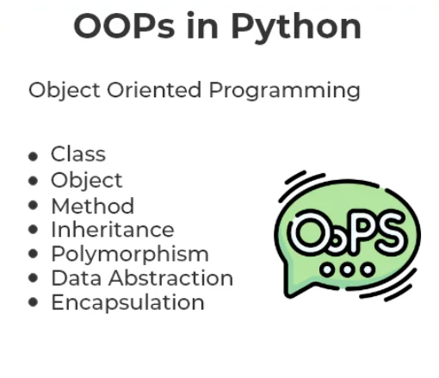
OOP In Python
Object-oriented programming (OOPs) is a method of designing a program by binding there related properties and behaviors into individual objects.

